Slide 1
Markov Decision Process

Slide 2
Agenda
Reinforcement Learning
MDP Components
Terminology
Markov Property
Markov Process or Markov Chain
Markov Reward Process (MRP)
Markov Decision Process (MDP)
Return (G_t)
Policy (π)
Value Functions
Optimal Value Functions

Slide 3
Reinforcement Learning
Reinforcement Learning is a type of Machine Learning.
It allows machines and software agents to automatically determine the ideal behavior within a specific context, in order to maximize its performance.
Simple reward feedback is required for the agent to learn its behavior; this is known as the reinforcement signal.
There are many different algorithms that tackle this issue. As a matter of fact, Reinforcement Learning is defined by a specific type of problem, and all its solutions are classed as Reinforcement Learning algorithms.
In the problem, an agent is supposed to decide the best action to select based on his current state. When this step is repeated, the problem is known as a Markov Decision Process.

Slide 4
Introduction
Most of the Reinforcement Learning (RL) problems can be addressed— a Markov Decision Process (MDP) is a mathematical framework used for modeling decision-making problems where the outcomes are partly random and partly controllable.

Slide 5
Terminology
Agent: An RL agent is the entity which we are training to make correct decisions (for eg: a Robot that is being trained to move around a house without crashing).
Environment: The environment is the surrounding with which the agent interacts (for eg: the house where the Robot moves). The agent cannot manipulate the environment; it can only control its own actions (for eg: the Robot cannot control where a table is kept in the house, but it can walk around it to avoid crashing).

Slide 6
Terminology
State: The state defines the current situation of the agent (for eg: it can be the exact position of the Robot in the house, or the alignment of its two legs, or its current posture; it depends on how you address the problem).
Action: The choice that the agent makes at the current time step (for eg: it can move its right or left leg, or raise its arm, or lift an object, turn right or left, etc.). We know the set of actions (decisions) that the agent can perform in advance.

Slide 7
Terminology
Policy: A policy is the thought process behind picking an action. In practice, it is a probability distribution assigned to the set of actions. Highly rewarding actions will have a high probability and vice versa.

Slide 8
Markov Decision Process (MDP) Components
A Markov Decision Process (MDP) model contains:
A set of possible world states S.
A set of Models.
A set of possible actions A.
A real-valued reward function R(s,a).
A policy the solution of Markov Decision Process.

Slide 9
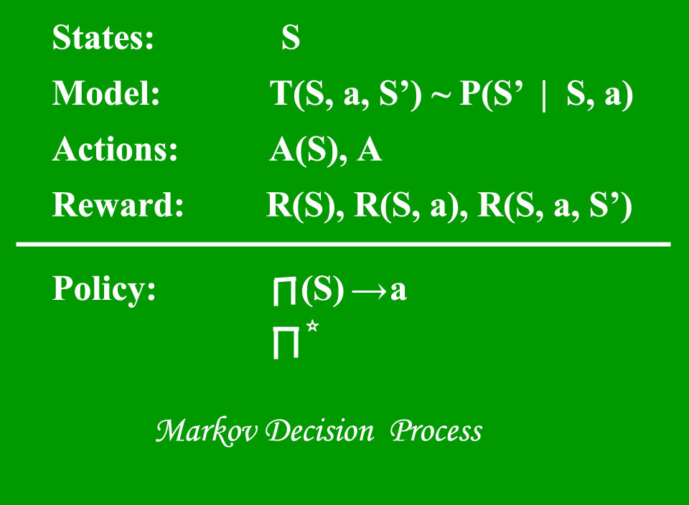

Slide 10
What is a State?
A State is a set of tokens that represent every state that the agent can be in.

Slide 11
What is a Model?
A Model (sometimes called Transition Model) gives an action’s effect in a state. In particular, T(S, a, S’) defines a transition T where being in state S and taking an action ‘a’ takes us to state S’ (S and S’ may be the same).
For stochastic actions (noisy, non-deterministic) we also define a probability P(S’|S,a) which represents the probability of reaching a state S’ if action ‘a’ is taken in state S. Note Markov property states that the effects of an action taken in a state depend only on that state and not on the prior history.

Slide 12
What are Actions?
An Action A is a set of all possible actions. A(s) defines the set of actions that can be taken being in state S.

Slide 13
What is a Reward?
A Reward is a real-valued reward function. R(s) indicates the reward for simply being in the state S. R(S,a) indicates the reward for being in a state S and taking an action ‘a’. R(S,a,S’) indicates the reward for being in a state S, taking an action ‘a’ and ending up in a state S’.

Slide 14
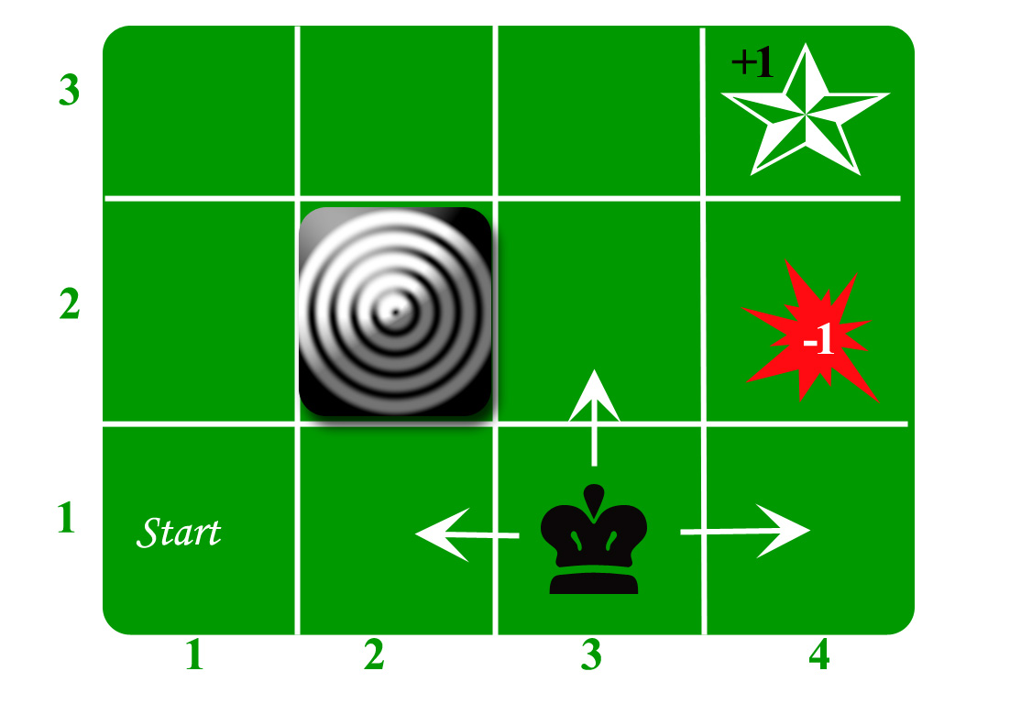
What is a Policy?
A Policy is a solution to the Markov Decision Process. A policy is a mapping from S to a. It indicates the action ‘a’ to be taken while in state S. Let us take the example of a grid world:

Slide 15
What is a Policy?
An agent lives in the grid. The above example is a 3*4 grid. The grid has a START state(grid no 1,1). The purpose of the agent is to wander around the grid to finally reach the Blue Diamond (grid no 4,3). Under all circumstances, the agent should avoid the Fire grid (orange color, grid no 4,2). Also the grid no 2,2 is a blocked grid, it acts as a wall hence the agent cannot enter it.
The agent can take any one of these actions: UP, DOWN, LEFT, RIGHT
Walls block the agent path, i.e., if there is a wall in the direction the agent would have taken, the agent stays in the same place. So for example, if the agent says LEFT in the START grid he would stay put in the START grid.

Slide 16
First Aim: To find the shortest sequence getting from START to the Diamond. Two such sequences can be found:
RIGHT RIGHT UP UPRIGHT
UP UP RIGHT RIGHT RIGHT

Slide 17
Example
Let us take the second one (UP UP RIGHT RIGHT RIGHT) for the subsequent discussion. The move is now noisy. 80% of the time the intended action works correctly. 20% of the time the action agent takes causes it to move at right angles. For example, if the agent says UP the probability of going UP is 0.8 whereas the probability of going LEFT is 0.1, and the probability of going RIGHT is 0.1 (since LEFT and RIGHT are right angles to UP).
The agent receives rewards each time step:-
Small reward each step (can be negative when can also be term as punishment, in the above example entering the Fire can have a reward of -1).
Big rewards come at the end (good or bad).
The goal is to Maximize the sum of rewards.

Slide 18
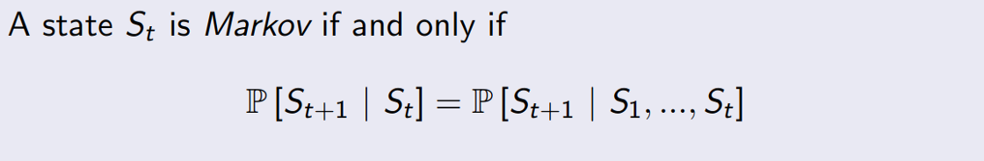
Markov Property
Assume that a Robot was seated on a chair, it stood up and put its right foot forward. So currently, it is standing with its right foot forward (this is its current state).
Now, according to the Markov Property, the current state of the Robot depends only on its immediate previous state (or the previous timestep) i.e., the state it was in when it stood up. And evidently, it doesn’t depend on the state where it was sitting on the chair. Similarly, its next state depends only on its current state.

Slide 19
Markov Property
Formally, for a state S_t to be Markov, the probability of the next state S_(t+1) being s’ should only be dependent on the current state S_t = s_t, and not on the rest of the past states S₁ = s₁, S₂ = s₂, …

Slide 20

Markov Process or Markov Chain
A Markov Process is defined by (S, P) where S are the states, and P is the state-transition probability. It consists of a sequence of random states S₁, S₂, … where all the states obey the Markov Property.

Slide 21
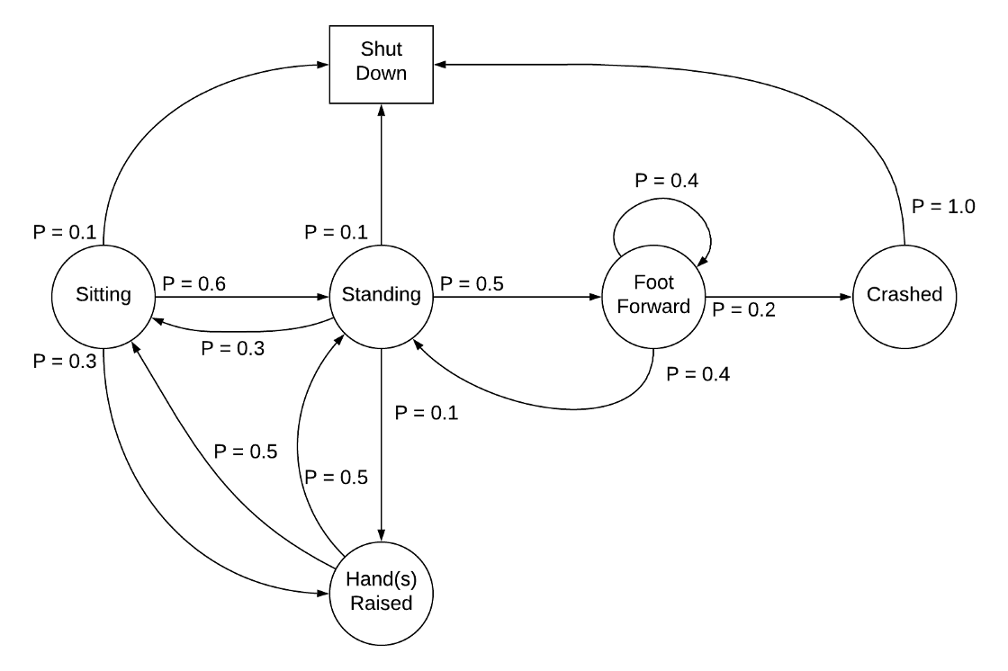
The state transition probability or P_ss’ is the probability of jumping to a state s’ from the current state s.

Slide 22
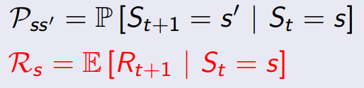
Markov Reward Process (MRP)
An MRP is defined by (S, P, R, γ), where S are the states, P is the state-transition probability, R_s is the reward, and γ is the discount factor

Slide 23
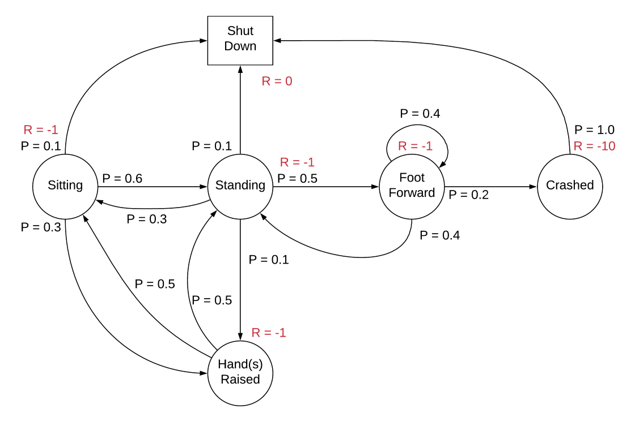
The state reward R_s is the expected reward over all the possible states that one can transition to from state s. This reward is received for being at the state S_t. By convention, it is said to be received after the agent leaves the state and hence, regarded as R_(t+1).

Slide 24
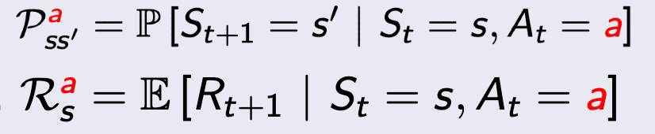
Markov Decision Process (MDP)
An MDP is defined by (S, A, P, R, γ), where A is the set of actions. It is essentially MRP with actions. Introduction to actions elicits a notion of control over the Markov Process, i.e., previously, the state transition probability and the state rewards were more or less stochastic (random). However, now the rewards and the next state also depend on what action the agent picks. Basically, the agent can now control its own fate (to some extent).

Slide 25
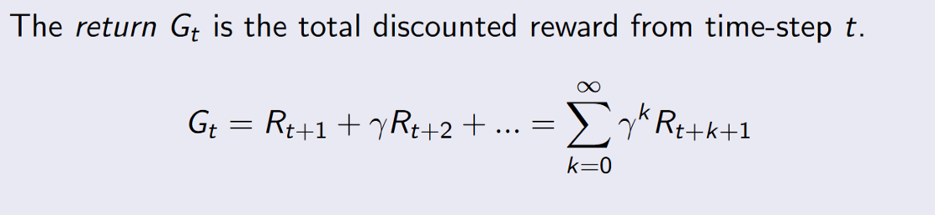
Return (G_t)
Rewards are temporary. Even after picking an action that gives a decent reward, we might be missing on a greater total reward in the long-run. This long-term total reward is the Return. However, in practice, we consider discounted Returns.

Slide 26
Discount (γ)
The variable γ ∈ [0, 1] in the figure is the discount factor. The intuition behind using a discount is that there is no certainty about the future rewards; i.e., as important it is to consider the future rewards to increase the Return, it is also equally important to limit the contribution of the future rewards to the Return (Since you can’t be 100% sure of the future).
And also because using a discount is mathematically convenient.

Slide 27
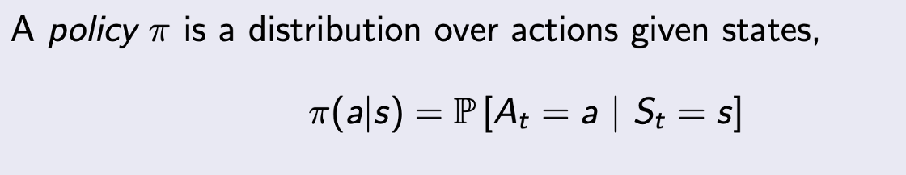
Policy (π)
As mentioned earlier, a policy defines the thought behind making a decision (picking an action). It defines the behavior of an RL agent.
Formally, a policy is a probability distribution over the set of actions a, given the current state s i.e., it gives the probability of picking an action a at state s.

Slide 28
Value Functions
A value function is the long-term value of a state or an action i.e., the expected Return over a state or an action. This is something that we are actually interested in optimizing.

Slide 29
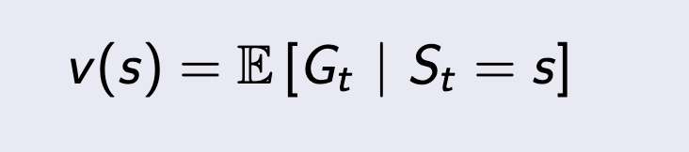
State Value Function (for MRP)
The state value function v(s) is the expected Return starting from state s.

Slide 30
Thank u

